Slide 1
grep
['a','1','b'].grep(/^\d*$/)
=> ["1"]
['a',1,'b'].grep(Integer)
=> [1]
[1,10,100,1000].grep(1..100)
['hello.rb','world.rb','public.html'].grep(/(.*)\.rb/){$1}

Slide 2
Class Constants
You can define a constant inside a class by assigning a direct numeric or string value to a variable which is defined without using either @ or @@.
class A
TEST=10
end
A::TEST
Class B
test=10
end
B::test
=>::test
NoMethodError: private method `test' called for B:Class
class A
TEST=10
def assign
TEST=20
end
end
SyntaxError: (irb):32: dynamic constant assignment
TEST=20
^

Slide 3
Ruby Singleton Pattern
Singleton is a design pattern that restricts instantiation of a class to only one instance that is globally available.
Single Instance of a class
class Logger
def initialize
@log = File.open("log.txt", "a")
end
@@instance = Logger.new
def self.instance
return @@instance
end
def log(msg)
@log.puts(msg)
end
private_class_method :new
end
Logger.instance.log('message 1')

Slide 4
Ruby Singleton module
require 'singleton'
class Logger
include Singleton
def initialize
@log = File.open("log.txt", "a")
end
def log(msg)
@log.puts(msg)
end
end
Logger.instance.log('message 2')

Slide 5
YAML
YAML is a format for structuring data in a file, like XML. Rails uses YAML to configure your databases, but it does so in such a way that you hardly notice. However, YAML is pretty neat, and you could be missing out.
YAML stands for "Yet Another Markup Language" (here). Or perhaps for "YAML Ain't Markup Language"
require 'yaml'
thing = YAML.load_file('/home/shrikanth/projects/chat_app/config/database.yml')
thing["development"]["val"]=3
File.open('/home/shrikanth/projects/chat_app/config/database.yml', 'w') {|f| f.write thing.to_yaml }

Slide 6
Rails Strenghs
Full Stack Framework
MetaProgramming
ActiveRecord
Convention Over Configurartion
Scaffolding
Built-in testing
Three environments

Slide 7
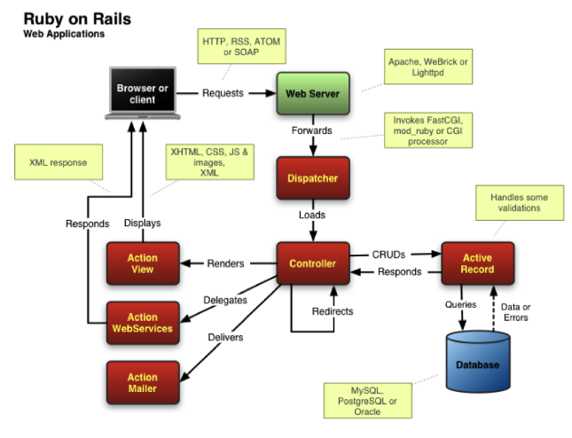

Slide 8
Rails Core Components
Action Mailer -Mailer with templates sending
ActionPack - does routing - the mapping of an incoming URL to a controller and action in Rails. It also sets up your controllers and views, and shepherds a request through its controller action and then through rendering the view. For some of it, ActionPack uses Rack. The template rendering itself is done through an external gem like Erubis for .erb templates, or Haml for .haml templates. ActionPack also handles action- or view-centered functionality like view caching.
ActiveSupport – Provides method to change from camel case to snake case. Date functions, internationalization, Time Zones.
ActiveModel – Responsible for validation. Introduced in rails3
require 'active_model'
class Person
include ActiveModel::Validations
validates_presence_of :first_name, :last_name
attr_accessor :first_name, :last_name
def initialize(first_name, last_name)
@first_name, @last_name = first_name, last_name
end
end
a = Person.new("Fred", nil)
a.valid? # => false
a.last_name = "Flintstone"
a.valid? # => true

Slide 9
ActiveRecord : Zero Configuration for CRUD functionality. Relies on convetion on how the class need to be named. Primary key and foreign key, Table name in the database.
ActiveResource:

Slide 10
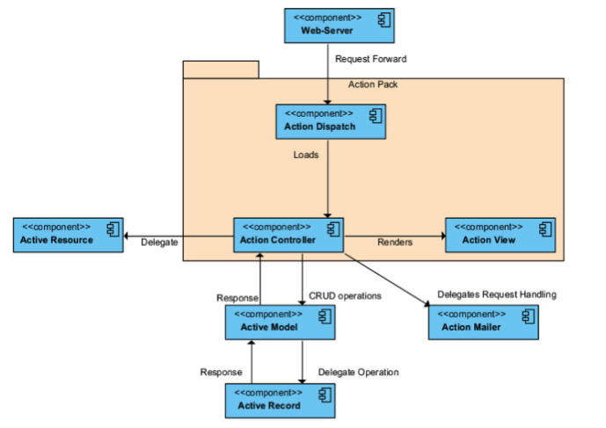
Connect and Component View

Slide 11
config/initializers
This directory contains the list of files that need to be run during the Rails initialization process. Any *.rb file you create here will run during the initialization automatically. For example, constants that you declare in here will then be available throughout your app. The initializer file is triggered from the call in config/environment.rb to Rails.application.initialize!.
lib
lib directory is where all the application specific libraries goes. Application specific libraries are re-usable generic code extracted from the application. Think of it as an application specific gem.
Rakefile
Rake files created inside the lib/tasks are available throughout the app via the Rake module. This is possible because of the Rakefile, which requires application.rb and invokes Rails.application.load_tasks. The call to load_tasks loads all the *.rake files from lib/tasks folder.
tmp
This is the temporary directory for the app to hold files like caches. You don’t need to worry about this directory, since it’s fully managed by Rails itself.
rails tmp:cache:clear clears tmp/cache.
rails tmp:sockets:clear clears tmp/sockets.
rails tmp:clear clears all cache and sockets files.
rails tmp:create creates tmp directories for cache, sockets and pids.

Slide 12
Generating a Controller
rails generate controller Greetings hello
create app/controllers/greetings_controller.rb
route get "greetings/hello"
invoke erb
create app/views/greetings
create app/views/greetings/hello.html.erb
invoke test_unit
create test/controllers/greetings_controller_test.rb
invoke helper
create app/helpers/greetings_helper.rb
invoke assets
invoke coffee
create app/assets/javascripts/greetings.coffee
invoke scss
create app/assets/stylesheets/greetings.scss

Slide 13
Strong Parameters
class PeopleController < ActionController::Base
# This will raise an ActiveModel::ForbiddenAttributes exception
# because it's using mass assignment without an explicit permit
# step.
def create
Person.create(params[:person])
end
# This will pass with flying colors as long as there's a person key
# in the parameters, otherwise it'll raise a
# ActionController::ParameterMissing exception, which will get
# caught by ActionController::Base and turned into that 400 Bad
# Request reply.
def update
person = current_account.people.find(params[:id])
person.update!(person_params)
redirect_to person
end
private
# Using a private method to encapsulate the permissible parameters
# is just a good pattern since you'll be able to reuse the same
# permit list between create and update. Also, you can specialize
# this method with per-user checking of permissible attributes.
def person_params
params.require(:person).permit(:name, :age)
end
end

Slide 14
Accessing the Session
The Flash
class LoginsController < ApplicationController
def destroy
session[:current_user_id] = nil
flash[:notice] = "You have successfully logged out."
redirect_to root_url
end
end
Note that it is also possible to assign a flash message as part of the redirection. You can assign :notice, :alert or the general purpose :flash:
redirect_to root_url, notice: "You have successfully logged out."
redirect_to root_url, alert: "You're stuck here!"
redirect_to root_url, flash: { referral_code: 1234 }

Slide 15
It's conventional to display any error alerts or notices from the flash in the application's layout:
<html>
<!-- <head/> -->
<body>
<% flash.each do |name, msg| -%>
<%= content_tag :div, msg, class: name %>
<% end -%>
<!-- more content -->
</body>
</html>
You can pass anything that the session can store; you're not limited to notices and alerts:
<% if flash[:just_signed_up] %>
<p class="welcome">Welcome to our site!</p>
<% end %>

Slide 16
If you want a flash value to be carried over to another request, use the keep method:
class MainController < ApplicationController
# Let's say this action corresponds to root_url, but you want
# all requests here to be redirected to UsersController#index.
# If an action sets the flash and redirects here, the values
# would normally be lost when another redirect happens, but you
# can use 'keep' to make it persist for another request.
def index
# Will persist all flash values.
flash.keep
# You can also use a key to keep only some kind of value.
# flash.keep(:notice)
redirect_to users_url
end
end

Slide 17
flash.now
By default, adding values to the flash will make them available to the next request, but sometimes you may want to access those values in the same request. For example, if the create action fails to save a resource and you render the new template directly, that's not going to result in a new request, but you may still want to display a message using the flash. To do this, you can use flash.now in the same way you use the normal flash:
class ClientsController < ApplicationController
def create
@client = Client.new(params[:client])
if @client.save
# ...
else
flash.now[:error] = "Could not save client"
render action: "new"
end
end
end

Slide 18
Cookies
Your application can store small amounts of data on the client - called cookies - that will be persisted across requests and even sessions. Rails provides easy access to cookies via the cookies method, which - much like the session - works like a hash:
class CommentsController < ApplicationController
def new
# Auto-fill the commenter's name if it has been stored in a cookie
@comment = Comment.new(author: cookies[:commenter_name])
end
def create
@comment = Comment.new(params[:comment])
if @comment.save
flash[:notice] = "Thanks for your comment!"
if params[:remember_name]
# Remember the commenter's name.
cookies[:commenter_name] = @comment.author
else
# Delete cookie for the commenter's name cookie, if any.
cookies.delete(:commenter_name)
end
redirect_to @comment.article
else
render action: "new"
end
end
end
Note that while for session values you set the key to nil, to delete a cookie value you should use cookies.delete(:key).

Slide 19
Rendering XML and JSON data
ActionController makes it extremely easy to render XML or JSON data. If you've generated a controller using scaffolding, it would look something like this:
class UsersController < ApplicationController
def index
@users = User.all
respond_to do |format|
format.html # index.html.erb
format.xml { render xml: @users}
format.json { render json: @users}
end
end
end

Slide 20
Filters are methods that are run "before", "after" or "around" a controller action.
Filters are inherited, so if you set a filter on ApplicationController, it will be run on every controller in your application.
"before" filters may halt the request cycle. A common "before" filter is one which requires that a user is logged in for an action to be run. You can define the filter method this way:
class ApplicationController < ActionController::Base
before_action :require_login
private
def require_login
unless logged_in?
flash[:error] = "You must be logged in to access this section"
redirect_to new_login_url # halts request cycle
end
end
end

Slide 21
class LoginsController < ApplicationController
skip_before_action :require_login, only: [:new, :create]
End
afrer_filter
after_filter is run after the content has been generated, but before it's been sent to the client. You can verify this is so because you have access to the completely-generated response data in the response method of your controller in any after_filter.

Slide 22
"around" filters are responsible for running their associated actions by yielding, similar to how Rack middlewares work.
For example, in a website where changes have an approval workflow an administrator could be able to preview them easily, just apply them within a transaction:
class ChangesController < ApplicationController
around_action :wrap_in_transaction, only: :show
private
def wrap_in_transaction
ActiveRecord::Base.transaction do
begin
yield
ensure
raise ActiveRecord::Rollback
end
end
end
end
Note that an "around" filter also wraps rendering. In particular, if in the example above, the view itself reads from the database (e.g. via a scope), it will do so within the transaction and thus present the data to preview.
You can choose not to yield and build the response yourself, in which case the action will not be run.

Slide 23
<%= form_for @user do |f| %>
<%= f.text_field :username %>
<%= f.text_field :password %>
<% end %>
<form accept-charset="UTF-8" action="/users/1" method="post">
<input type="hidden"
value="67250ab105eb5ad10851c00a5621854a23af5489"
name="authenticity_token"/>
<!-- fields -->
</form>
If you're writing a form manually or need to add the token for another reason, it's available through the method form_authenticity_token:
The form_authenticity_token generates a valid authentication token. That's useful in places where Rails does not add it automatically, like in custom Ajax calls.

Slide 24
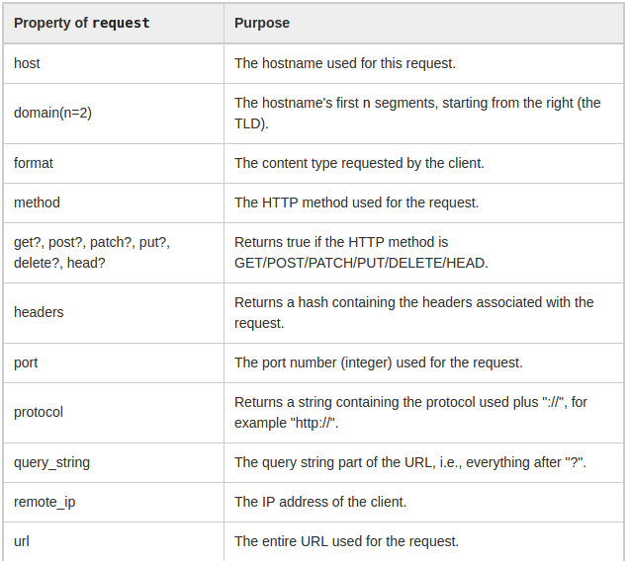
The request Object

Slide 25
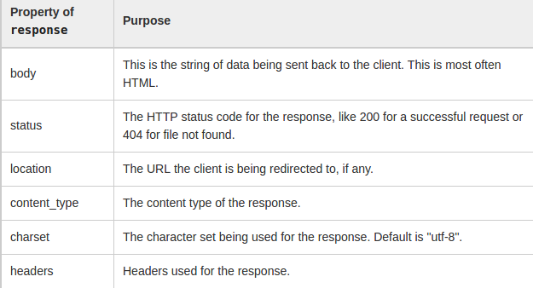
render status: 404
response.headers["location"]="/"
response.content_type="text/html"

Slide 26
Setting Custom Headers
response.headers["Content-Type"] = "application/pdf"
send_file
send_file("#{Rails.root}/files/clients/client.pdf",
filename: "name}pdf",
type: "application/pdf")

Slide 27
Restful Downloads
class ClientsController < ApplicationController
# The user can request to receive this resource as HTML or PDF.
def show
@client = Client.find(params[:id])
respond_to do |format|
format.html
format.pdf { render pdf: generate_pdf(@client) }
end
end
end
config/initializers/mime_types.rb:
Mime::Type.register "application/pdf", :pdf
GET /clients/1.pdf

Slide 28
Parameters Filtering
config.filter_parameters << :password
rescue_from
class ApplicationController < ActionController::Base
rescue_from ActiveRecord::RecordNotFound, with: :record_not_found
private
def record_not_found
render plain: "404 Not Found", status: 404
end
end
class ApplicationController < ActionController::Base
rescue_from User::NotAuthorized, with: :user_not_authorized
private
def user_not_authorized
flash[:error] = "You don't have access to this section."
redirect_back(fallback_location: root_path)
end
end

Slide 29
Force HTTPS protocol
class DinnerController
force_ssl
end
class DinnerController
force_ssl only: :cheeseburger
# or
force_ssl except: :cheeseburger
end

